Slide 1
Docker

Slide 2
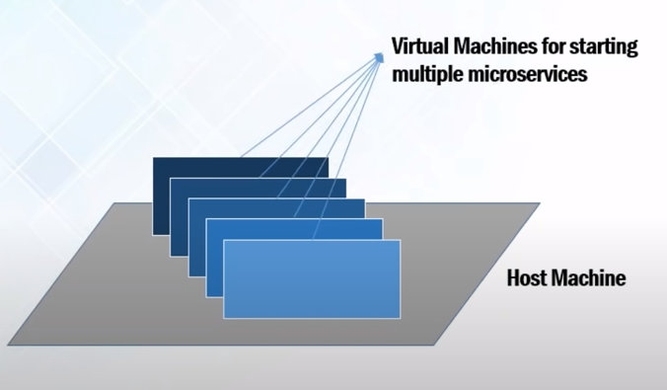
Problem before Docker
An application works in developer’s laptop but not in testing or production. This is due to difference in computing environment between dev, test and prod.
Developing an application requires starting several of microservices in one machine. So if you are starting ten of those services you require ten VMs on that machine.

Slide 3
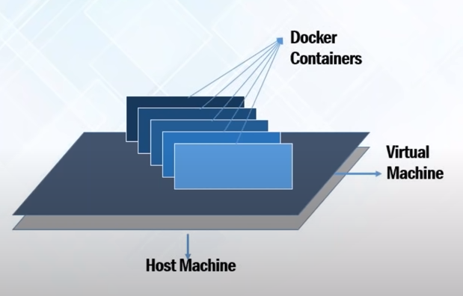
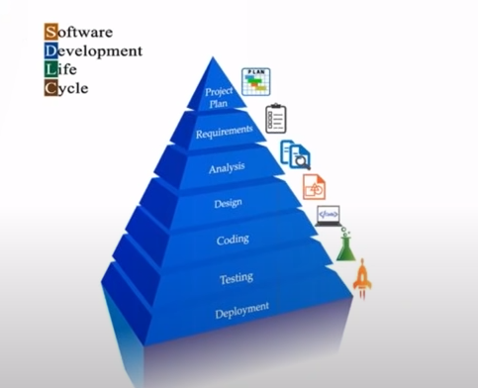
How Docker solve problem
You can run several microservices in the same VM by running various Docker containers for each microservice.
Provide a consistent computing environment throughout the SDLC. Containers are created by developer only, so we can use same environment throughout the SDLC Dev, Test, Prod. So there will not be difference in computing environment.

Slide 4
Docker Overview
Docker is an open platform for developing, shipping, and running applications.
Docker enables you to separate your applications from your infrastructure so you can deliver software quickly.
Docker provides the ability to package and run an application in a loosely isolated environment called a container.
Containers are lightweight because they don’t need the extra load of a hypervisor, but run directly within the host machine’s kernel.
You can run more containers on a given hardware combination than if you were using virtual machines.
You can even run Docker containers within host machines that are actually virtual machines.

Slide 5
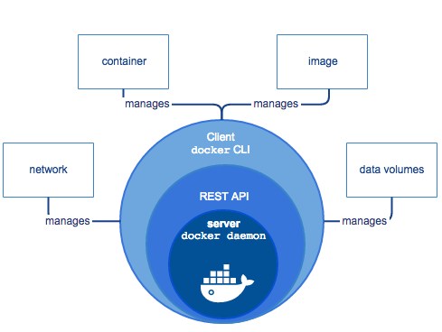
Docker Engine
Docker Engine is a client-server application with these major components:
A server which is a type of long-running program called a daemon process (the dockerd command).
A REST API which specifies interfaces that programs can use to talk to the daemon and instruct it what to do.
A command line interface (CLI) client (the docker command).
https://docs.docker.com/engine/api/v1.24/

Slide 6
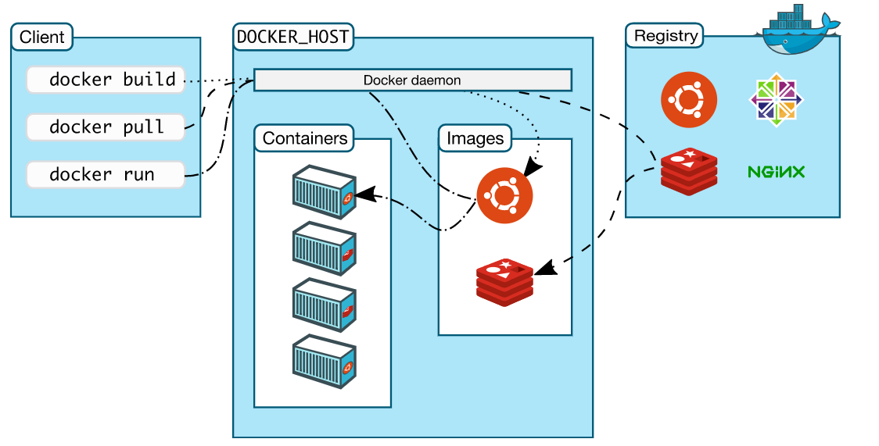
Docker architecture
Docker uses a client-server architecture.

Slide 7
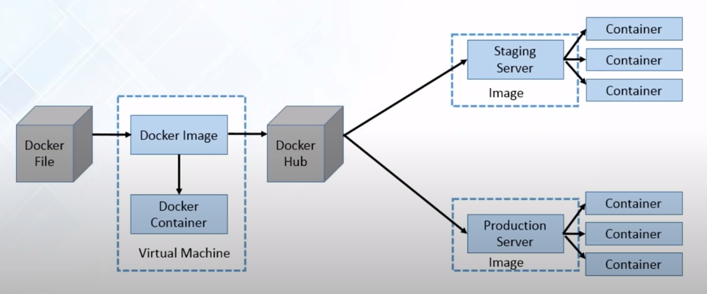
Docker Workflow
Docker File:- Developer write code that defines application, requirement and dependency in an easy to write file, called as Docker File.
Docker Image: - Docker File produces Docker Image. All the dependency are present in Docker Image.
Docker Container:- Docker container are run-time instance of Docker Image.
Docker Hub:- Docker Hub contains Docker Images. It behave like git repository, which contains public and private Docker Images.

Slide 8
Docker commands
Service docker status
Check docker status
Service docker start
Start docker
Docker info
Get docker info
Docker version
Check docker version
Docker --help
Find help

Slide 9
Docker Container Commands
Docker container run <image name>
Create a new container and run that container
Docker container rm <container id/name>
Remove a container
Docker container rm $(docker container ls –aq)
Remove all container
Docker container ls
Show list of running containers
Docker container ls –a
Show list of all(running and stopped) containers
Docker container start <container id/name>
Start an existing container
Docker container inspect <container id/name>
Show all information of container
Docker container stop <container id/name>
Stop a running container
Docker container top <container id/name>
Display all running process inside container
Docker container logs <container id/name>
Display Logs of specified container

Slide 10
Docker Container Commands
Docker container stats
Display stats of all running container.
Docker container exec –it <container id> /bin/bash
Execute a command inside a running container.
Docker container rename <container id> <container new name>
Rename a container.
Docker container restart <container id>
Restart a container.
Docker container kill <container id>
Kill a container by forcefully.
Docker container attach <container id>
Attach a detached container to the console.
Docker container wait <container id>
Wait for the container to be exit. As soon as container exit, it will return container’s exit status.
Docker container pause <container id>
Will pause all the process of a running container. Will not able to access the paused container.
Docker container unpause <container id>
Will unpause all the process of a running container.

Slide 11
Docker Container Commands
Docker container prune
Will delete all stopped container
Docker container port <container id/name>
Display port mapping of container.
Docker container create <image name>
Create container
Docker container diff <container id>
Display list of files in a container
Docker container cp <source file> <container id>:/<destination path>
Copy file from host to container
Docker container export <container id> -o my_container.tar
Docker container export <container id> > my_container.tar
Export a container
Docker image import <tar container file name> <image custome name>
Create image from container tar file

Slide 12
Docker command Options
-d (docker container run –d nginx)
-it (docker container run –it ubuntu /bin/bash)
-p <hostport:container_port> (docker container run -d –p 3600:80 nginx)
--name <container name> (docker container run --name my_container ubuntu)

Slide 13
Docker Image Commands
docker image ls
docker images
List all images available in local system. Both commands are same
docker image ls --format ‘{{.ID}} , {{.Repository}}’
Display image ID and Repository by comma separated. https://docs.docker.com/engine/reference/commandline/images/ link to find format options
docker pull <image name>
Pull image from docker hub
docker container commit <container id> --author “pankaj” <new image name>
Create docker image from running container
docker image inspect <image name>
Inspect an image. Main things to look here are Container, ExposedPorts, Tty, Env, Volumes, WorkingDir
docker image rm <image name>
Remove image. make sure image is not attached to any container.
docker image prune
Will delete all unused image, images which are not attached to any container
docker image rm -f <image name>
Remove image forcefully

Slide 14
Docker Image Commands
docker image history <image name>
Display history of image
docker login
Login in the docker hub. It will ask your docker hub username and password.
docker image tag <image name> <hub.docker.com/<account name>/<image name>
docker image tag <image name> <hub.docker.com/pankaj/my_image>
Assign tag to docker image to push image to docker hub. “hub.docker.com” repo name is default. No need to add. But it’s custom repo, then we have to specify.
docker push <image name>
Push image to docker hub. Make sure you have logged in before you push.
docker image save <image name> > <image_name.tar>
Will save the to the standard output.
docker image load < <image_name.tar>
Will load image from standard input.
difference between "docker container export" and "docker image save“
docker image save -> will save all layers, all versions, all Tags, all Repo of image. We have to specify image versions, otherwise it will save all things in tar file.
docker container export -> Will export only the running container. If any volume is attached to container, then this command will not take backup of that volume.
difference between "docker image load" and "docker image import“
docker image load -> will load all layers, versions, Tags, Repo of image.
docker image import -> will import only a single layer of image, like ubunut:latest

Slide 15
Dockerfile
A Dockerfile is a script/text configuration file that contains collections of commands and instructions that will be automatically executed in sequence in the docker environment for building a new docker image. This file is written in a popular, human-readable Markup Language called YAML.
The docker build command processes Dockerfile generating a Docker Image in your Local Image Cache, which you can then start-up using the docker run command, or push to a permanent Image Repository.
When we try to build Dockerfile using command "docker build", by default it will search file named as "Dockerfile" in the specified directory, and start building the Dockerfile. You don't need to specify file name.
If you give any other file name, then you have to specify file name along with -f option.

Slide 16
Dockerfile Commands
vi Dockerfile
Create Dockerfile
docker image build –t <custom image name>:<tag id> <path of Dockerfile>
docker image build –t my_image:1 .
This command will build the Dockerfile and create the image. Once image is ready, you can create container from this image, but make sure that you specify image name and image tag id while creating container.
Here . specified as the Dockerfile file is in current directory.
docker image

Slide 17
Layered Architecture
Exm1:-
FROM ubuntu
RUN apt-get update && apt-get install -y tree
This command will build image in 2 layer. 1st layer would be ubuntu, which will be taken from cache if available, otherwise will fetch from Dockerhub and 2nd layer will be to update apt-get and install tree command.
Each line in Dockerfile create a seprate layer.
Exm2:-
FROM ubuntu
RUN apt-get update && apt-get install -y tree
RUN touch /tmp/pankaj.txt
RUN touch /tmp/amar.txt
RUN touch /tmp/haritha.txt
RUN touch /tmp/shan.txt
RUN touch /tmp/boney.txt
This command will build image in 7 layers. If we see overall images, we will see many images, because each layer has created seprate image. Each layer is run inside a intermediate container, which will be removed when each single command has finished it's work in layer.

Slide 18
Layered Architecture
Exm3:-
FROM ubuntu
RUN touch /tmp/temp.txt
RUN apt-get update && apt-get install -y tree
RUN touch /tmp/pankaj.txt
RUN touch /tmp/amar.txt
RUN touch /tmp/haritha.txt
RUN touch /tmp/shan.txt
RUN touch /tmp/boney.txt
This command will build image in 8 layers. This will not take things from cache as we have changed in 2nd line, so from 2nd command each line will run inside a new layer.
Make sure we are not changing anything in mid of a Dockerfile. Always try to add anything at the end of file, because it will save your time in building image.
Always try to run "RUN" command in single line.

Slide 19
Dockerfile Keywords
LABEL
LABEL <label name>=<"label value">
LABEL name="Pankaj Gupta"
LABEL email=pankajg@microland.com
When we inspect a image, then inside Config->Labels we will find these LABEL.
ENV
ENV <env_name> <env_value>
ENV USERNAME username
ENV PASSWORD password
Create container from this image and enter inside the container. Type "env" command in container, you will see Environment.
WORKDIR
WORKDIR <directory name>
WORKDIR /tmp
COPY
COPY <source path of file> <destination folder of container file>
COPY pankaj /tmp/pankaj/
Copy file from my host pankaj folder to container's folder /tmp/pankaj

Slide 20
Dockerfile Keywords
ADD
ADD <source path of file> <destination folder of container file>
ADD pankaj /tmp/pankaj/
ADD command is almost same as COPY command. Just use ADD instead of COPY.
The difference is if we add any .tar or .zip file using COPY command, it will copy the same in the destination folder. But if we add any .tar or .zip file using ADD command, it will copy the content of .tar file, instead of that .tar file.
CMD
Exec form -> CMD ["executable","param1","param2"]
Default parameters to ENTRYPOINT -> CMD ["param1","param2"]
Shell form -> CMD command param1 param2
There can only be one CMD instruction in a Dockerfile. If you list more than one CMD then only the last CMD will take effect.
The main purpose of a CMD is to provide defaults for an executing container.
ENTRYPOINT
Exec form -> ENTRYPOINT ["executable", "param1", "param2"]
Shell form -> ENTRYPOINT command param1 param2
ENTRYPOINT [“tree“]
ENTRYPOINT behave same like CMD.

Slide 21
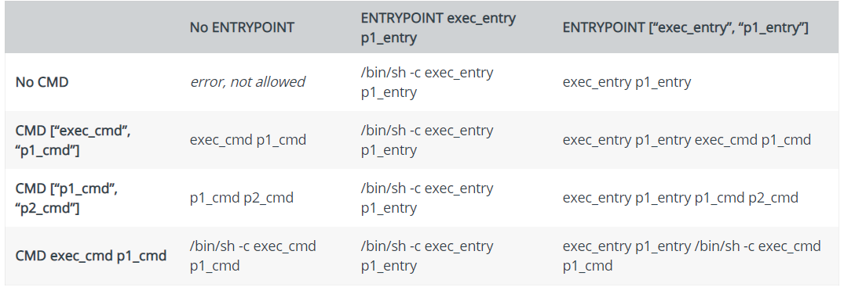
CMD vs ENTRYPOINT
Both CMD and ENTRYPOINT instructions define what command gets executed when running a container. There are few rules that describe their co-operation.
Dockerfile should specify at least one of CMD or ENTRYPOINT commands.
ENTRYPOINT should be defined when using the container as an executable.
CMD should be used as a way of defining default arguments for an ENTRYPOINT command or for executing an ad-hoc command in a container.
CMD will be overridden when running the container with alternative arguments.

Slide 22
Docker Volume Commands
docker volume create <volume name>
Create volume
docker volume ls
List all volumes.
docker container run -e MYSQL_ALLOW_EMPTY_PASSWORD=true mysql
Run mysql container without password. When we run mysql container, docker will automatically created a volume and will mount it to /var/lib/mysql in container.
docker container run -itd –v <volume id/name>:<path of volume in container> <image name>
docker container run -itd –v abcd:/var/lib/mysql mysql
This command will create a new container and instead of creating a new volume, it will map "abcd" volume to the "/var/lib/mysql" folder of my mysql container.
docker volume inspect <volume name>
Inspect the volume.
docker volume rm <volume name>
Remove the volume.
docker volume prune
Remove all unused volume.
docker container run -it -v <path of host machine folder>:<path of docker container folder where i want to mount> <image name>
docker container run -it -v /home/pankaj:/tmp/test/ ubuntu bash
This command will bind the folder of host machine into the folder of container. If the container's folder is not available, then this command will automatically create that folder. Whatever file exist in host machine folder, that will be shown into mount folder of running container. If we change anything in that folder inside running container, then we will see those changed in the host mounted folder also.
We should always give full path of host machine folder. If we will not give full path then this command will create a new volume with the specified name.

Slide 23
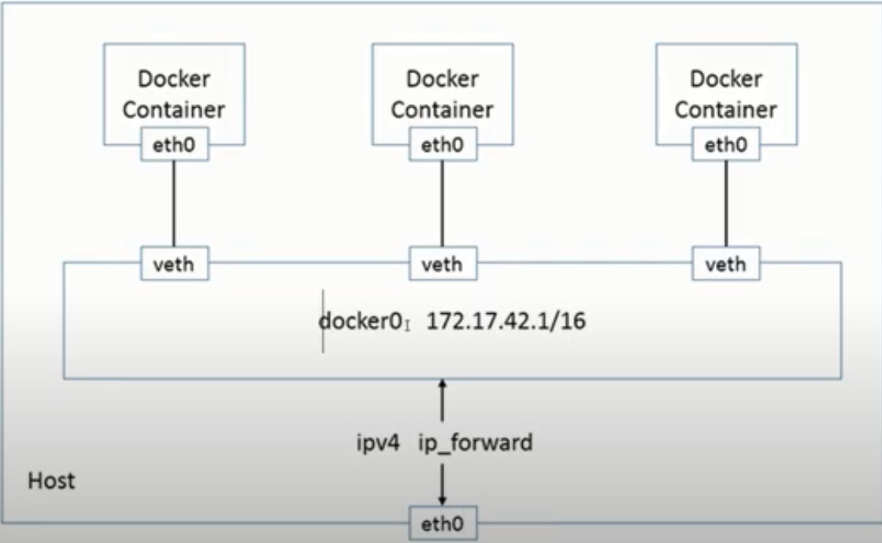
Docker Networking
By default, docker provide some network.
By default, a container is connected to bridge network.
Run ifconfig command to show all networks and virtual host.
Whenever we attach container to network, it always create pair. One veth will be in docker and another eth will be inside container.

Slide 24
Docker Networking
docker network ls
List all the network
docker network create –d <network driver type> <network custom name>
docker network create –d bridge pankaj
Create a network with specified driver type. If we do not specify driver type, by default it will take as bridge.
docker network inspect <network name>
Inspect the network
docker network rm <network name>
Remove a network
docker network prune
Remove all unused network
docker network connect <network name> <container name>
Connect a network to the container
docker network disconnect <network name> <container name>
Disconnect a network from a container.
Docker container run –it --network=<network name> <image name> <command>
Docker container run –it --network=pankaj ubuntu /bin/bash
Run a ubuntu container and assign ‘pankaj’ network to it.

Slide 25
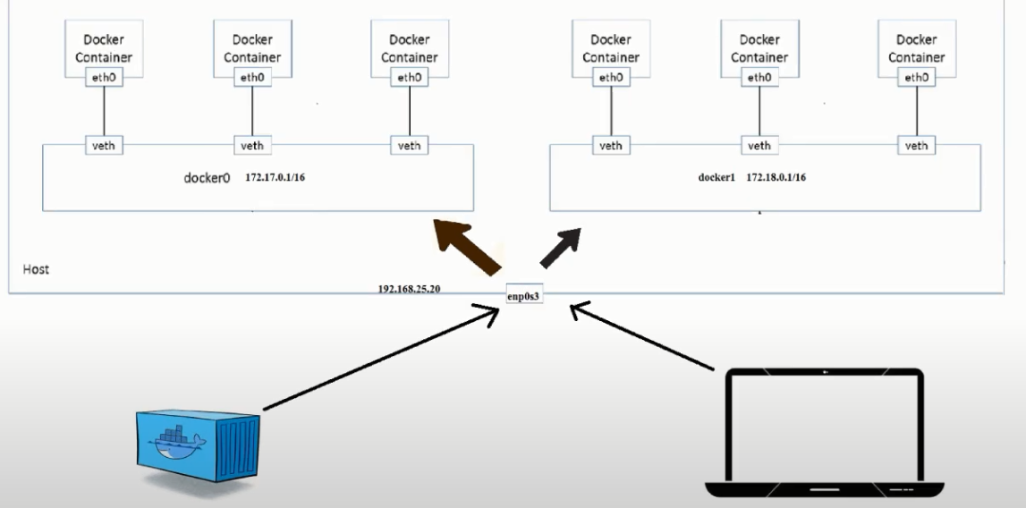
Docker Bridge Network
Create 2 container and attach them with pankaj network. And create another container attach it with default network.
Now type command as “ip a”. You will see the virtual ethernet and with which container they are connected.
If my two container are attached in same network, then we can ping each other by going inside them directly without opening the port. But if containers are not connected like one is connected to default container and another is connected to pankaj container, then we can’t ping each other, if you want to ping then you have to open the port.

Slide 26
Docker Networking (DNS Enable)
Till now we were pinging using IP address of container. Now we want to ping through hostname.
When we create a custom network, then DNS is by default enabled in that network. Means we can ping a container by it’s hostname from another container, but they should be in same custom network.
Docker provide bridge network by default, in this default bridge network DNS is not enabled. But I want that DNS should be enabled in the bridge network, in that case first you delete the default bridge network and create a custom network with bridge name and bridge driver. Now this bridge network became custom network, and hostname is enabled here also.

Slide 27
Docker Host and Null Network
When we create a container, by default it create a lot of Namespace (PID, NAME, Network, MOUNT, IPC, USERNAME). If we use Host network while creating container, then our NETWORK namespace will not be isolated. My entire container will be isolated, except NETWORK namespace.
If you will create container using Host network, then type “ifconfig” command in docker host and docker container, you will find same output.
We can’t create more than one host network. By default, docker network give us a host name network whose driver type is host. If we try to create custom network with another name and give it’s driver type as host, then it will show error.
If you want that you container should not attach to any network, then assign None network to that container while creating container.
--network=none

Slide 28
Docker Network (Connect, Disconnect)
Docker network connect <network name> <container name/id>
Docker network connect pankaj my_container
If you want to connect a container with multiple network, then we will use Connect command.
Exm :- Now Create one custom bridge network. Create container with default bridge network. Came out from running container and execute Connect command to connect another custom created network to the running container.
Docker network disconnect <network name> <container name>
Docker network disconnect pankaj my_container
If your container has multiple network, and you want to disconnect any network, then use Disconnect command.
Question 1:- Suppose I created a container with None network, now can I assign my custom bridge network to that container.
Question 2:- Suppose I created a container with host network, now can I assign my custom bridge network or None network to that container.

Slide 29
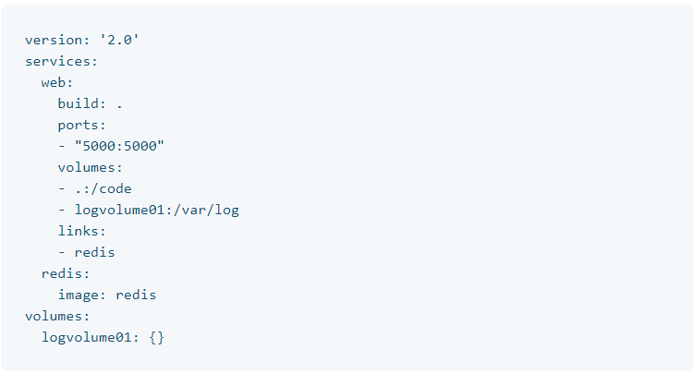
Docker Compose
Compose is a tool for defining and running multi-container Docker applications. With Compose, you use a YAML/YML file to configure your application’s services. Then, with a single command, you create and start all the services from your configuration.
Compose works in all environments: production, staging, development.
Using Compose is basically a three-step process:
Define your app’s environment with a Dockerfile so it can be reproduced anywhere.
Define the services that make up your app in docker-compose.yml so they can be run together in an isolated environment.
Run docker-compose up and Compose starts and runs your entire app.

Slide 30
Docker Compose
A service definition contains configuration that is applied to each container started for that service, much like passing command-line parameters to docker run. Likewise, network and volume definitions are analogous to docker network create and docker volume create.
As with docker run, options specified in the Dockerfile, such as CMD, EXPOSE, VOLUME, ENV, are respected by default - you don’t need to specify them again in docker-compose.yml.
You can use environment variables in configuration values with a Bash-like ${VARIABLE}
sudo curl -L "https://github.com/docker/compose/releases/download/1.26.2/docker-compose-$(uname -s)-$(uname -m)" -o /usr/local/bin/docker-compose
sudo chmod +x /usr/local/bin/docker-compose

Slide 31
Docker Compose Features
Multiple isolated environments on a single host
Compose uses a project name to isolate environments from each other. You can make use of this project name in several different contexts:
on a dev host, to create multiple copies of a single environment, such as when you want to run a stable copy for each feature branch of a project
on a CI server, to keep builds from interfering with each other, you can set the project name to a unique build number
on a shared host or dev host, to prevent different projects, which may use the same service names, from interfering with each other
The default project name is the basename of the project directory. You can set a custom project name by using the -p command line option or the COMPOSE_PROJECT_NAME environment variable.
Preserve volume data when containers are created
Compose preserves all volumes used by your services. When docker-compose up runs, if it finds any containers from previous runs, it copies the volumes from the old container to the new container. This process ensures that any data you’ve created in volumes isn’t lost.
Only recreate containers that have changed
Compose caches the configuration used to create a container. When you restart a service that has not changed, Compose re-uses the existing containers. Re-using containers means that you can make changes to your environment very quickly.
Variables and moving a composition between environments
Compose supports variables in the Compose file. You can use these variables to customize your composition for different environments, or different users.

Slide 32
Docker Compose Commands
docker-compose up
This command will search docker-compose.yml file in current directory and will create container, volume, network which are define in docker-compose.yml file and will run the containers.
docker-compose down
This command will stop all container/network which are define in docker-compose.yml file. This command will not delete Volumes.
docker-compose down –volume
This command will delete everything including Volumes.
docker-compose –f <yaml file name> up
docker-compose –f pankaj.yml up
This command is used to run .yml file if you specify any other name instead of docker-compose.yml.
docker-compose create
This command will only create container from docker-compose file, it will not start them. But this command will not create network.
docker-compose up --no-start
This command word similar to Create command, but this command will create Network also.
docker-compose start
This command will start the container which are defined in docker-compose file. But make sure that you have earlier created these container using Create command.
docker-compose stop
This command will stop the running container which are defined in docker-compose file.
docker-compose rm
This command will remove all containers which are defined in the docker-compose file. Make sure this command will not delete the Network, which is defined in docker-compose fie.

Slide 33
Docker Compose Commands
docker-compose images
This command will not give any output. Because docker-compose never build docker image.
docker-compose pause
This command will pause the Container, which are in docker-compose.yml file.
docker-compose unpause
This command will unpause the Container, which are in docker-compose.yml file.
docker-compose ps
This command will tell the status of all the container, which are in docker-compose file.
docker-compose kill
This command will kill the containers, which are in docker-compose file.
docker-compose port <service_name> <port_number>
docker-compose port my_nginx 80
This command will tell which host port is mapped to my port 80 of my_nginx.
docker-compose logs –f
This command will attached to the terminal. Now whatever container you will access, it will show you all the current logs.
docker-compose exec <service name> <command>
docker-compose exec pankaj ls
This command will execute specified command in the specified running container. And will show the output in your current screen.
docker-compose run <service name> <command>
docker-compose run pankaj ls
This command will create a new container from pankaj service and execute specified command in that newly created container and finally exit from that container and display the output in your current screen.

Slide 34
Docker Compose Commands
docker-compose restart
This command will restart the container.
docker-compose pull
This command will only pull the image from docker hub.
docker-compose scale <service name=no of new container> <service name=no of new container>
Docker-compose scale pankaj=4 gupta=1
This command will create new container of the specified service as the number specified. We can specify as many service and as many numbers.
docker-compose top
This command will tell the running process inside running container.
docker-compose

Slide 35
Docker Compose Example
version: ‘2’
services:
database:
image: mysql
ports:
- “3306:3306”
environment:
- MYSQL_ROOT_PASSWORD=password
- MYSQL_USER=user
- MYSQL_PASSWORD=password
- MYSQL_DATABASE=demo
web:
image: nginx

Slide 36
Docker Swarm Commands
docker service create <image name> <command>
docker service create alpine ping 1.1.1.1
This command will create service with the specified image. Service is like container.
docker service create -d --replicas 4 alpine ping 1.1.1.1
This command will create alpine and it 4 replicas. –d option is to run in background.
docker service create -d -p 8000:80 nginx
This command will create nginx service and map the port.
docker service create --mode=global 8000:80 nginx
This command will run nginx service on each host. If you add a new server then automatically nginx service will be activated on that new added server.
docker service create --replicas=3 --constraint='node.role==manager' alpine ping 1.1.1.1
This command will create containers only on manager.
docker service create --replicas=3 --constraint='node.role==worker' alpine ping 1.1.1.1
This command will create containers only on worker.
docker service ls
This command will list all the services.
docker service inspect <service name>
This command will inspect the service.
docker service logs <service name>
This comand will show logs of specified service.
docker service scale <service id>=<no of replicas>
This service will increate no of replicas of specified service.
docker service ps <service name/id>
This command will show the status of specified service.

Slide 37
Thanks

